Slide 1
Finance Dept: Cost Control proposal
System implementation - ERP
planning, budgeting, Communication (Integration) & control

Slide 2
Index
Introduction
System Implementation Overview – ERP
Accurate Business Portfolio Report
Why Business Analyzing
Roadmap
Goals
Cost Control – Financial Prospective
Quality Control – Customers Prospective
Documentation – Internal Processes
Learning & Growth
Estimation (Initial Budget)
Planning - Project Lifecycle
Planning - Product Lifecycle (Route)
Planning - Activity Based Cost Analyzing - ABC (Cost Driver)
Planning - Activity Time Schedule (WBS)
Planning - Project Cost Structure Standardization
Planning - Product (Industrial) Cost Structure Standardization
Planning - Project Cost Structure Standardization CSI
Planning - Project/Product (Industrial) Budgeting Based on WBS & ABC
Outsourcing (Alternatives) Study
ERP System Implementation
Documents Lifecycle, Integration & Control
Requirements

Slide 3
INTRODUCTION

Slide 4
System Implementation Overview - ERP
Subject | Business Analysis (Independency & Integration)
 | Project/Product/Activity | Program/Division/LOB/SBU | Portfolio
Field | Specific & SMART Targets | Has Extended Field & Achieving Greater Business Benefit | The Field Changes as per Business Strategy Vision
Change | Change Forecasting & Management | Program Management has to be Ready to Handle any internal or external environmental Changes, In Addition to Accept it | Follow-up & Monitoring all Change Kinds & Focus in its effect on any Particular of Business
Planning | Detailed Plan (Action Plans) through The Project life Cycle - Gradually Feed of information to the Teams | Program Management has to Develop a Contain Plan which has Balanced Score Cards that is guide to Easily prepare Action (Detailed) Plans | Portfolio Management has to work on the Necessary Operations that are belong Portfolio
Administration | Project Manager Leads teams to Achieve the Project Targets | The Program Manager concerns with Stakeholders Management in Addition to Work Teams | The Portfolio Manager concerns with Coordination & Communication between Projects, Programs and Stakeholders
Success | Product (Project) Quality, Time Schedule & Customer Satisfaction | Stakeholders Satisfaction, Saturation of Needs & Gained Benefits | The Total Performance of the Portfolio
Control | The Project manager has to control Activities Conclusion (Product, Service or any Project Targets) | The Program manager has to Control and Monitor Projects Conclusion (to Achieve Program Goals), Time Schedule & Budget Management | The Portfolio manager has to Monitor & control Business Performance & Values Pointers (Ratios)

Slide 5
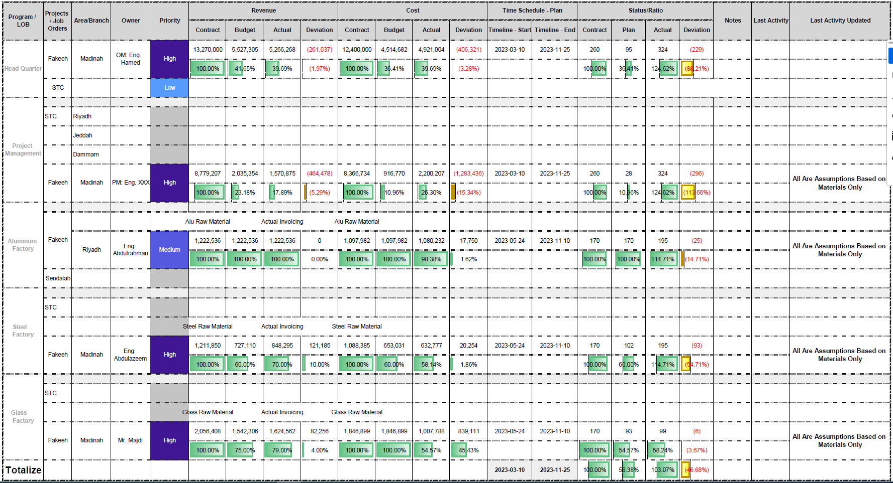
How to Appears in Business Portfolio?
Assumption As Per Quantity
Assumption As Per Quantity
Actual As Per Value
Actual As Per Value

Slide 6
Why we Have to Make all Departments independent & integrated (ERP)
Accurate Measuring of Completion Ratios (Quantities, Values & Time)
Comparing Actual Time Schedule VS Planned (Time Management)
Time Cost (Concept)
Budgeting: Revenue, Project, Production & Alternatives Study
Business Portfolio Overview
Integrate Project Management with Production Management - lifecycle & Plan
Accountability

Slide 7
RoadMap
Action Plan
Project Plan
Production Plan
Budgeting
Project Sales Budget
Outsourcing (Alternatives)
Communications
• Project Lifecycle
• Product Lifecycle
• Tasks & Activities
• Documents Lifecycle
• Privileges & Permissions
Project Cost Budget
Production Cost Budget
Control
• BOQ Control
• Cost Price
• Inventory Turnover
• Alternative Study
• Gaps Analysis &
Recommendations
Purchase Plan
HR Plan
Finance Plan

Slide 8
Goals

Slide 9
Cost Control – Financial Prospective
Achieving the Highest Profit Rate & ROI
Inventory Monitoring (Inventory Turnover Rate & Risks)
Achieving the Best Use of Financial Resources
Performance Monitoring (PKIs)

Slide 10
Quality Control – Customers Prospective
Achieving the Customer Satisfaction
Achieving the Best Use of the Company Resources (4M)

Slide 11
Documents Control – internal processes
Achieving Data Availability (No Lack of Information)
Easing Data-Flow
Documents Keeping

Slide 12
Learning & growth
Professional Reports (Help Decision Makers)
Knowledge Accumulative
Sustainable Development

Slide 13
Requirements

Slide 14
Estimation Budget – before contract
Partial Sales Budget | 10239 – Fakeeh hospital
Partial Cost Budget 10239 – Fakeeh hospital
T-Price | U-Price | QTTY | SPECs | Item Description | Item Code
1,204,773 | 216.37 | 5,568 | Zone A Front elevation Hinged Window Inside curtainwall – ALUPCO 56D Alupco-AT-1500-Length 5100-Hight FOUR SIDED FIXED STR'L GLAZED CURTAIN WALL | Aluminum Frames Delivery & Installation | CW01-W01
3,413,523 | 613 | 5,568 |  | Glass/ACP Delivery | CW01-W01
1,003,977 | 180 | 5,568 |  | Glass Installation | CW01-W01
33,440 | 160 | 209 | ADDITIONAL PRICE FOR CURTAIN WALL FOR OPERABLE PANEL DUE TO ADDITIONAL THERMAL BREAK PROFILES FOR ALUMINUM FRAME, ALUMINUM LEAF AND ACCESSORIES & HARDWARE | Window Delivery | CW01- OPENINGS
100,320 | 480 | 209 |  | Window Delivery & Install | CW01- OPENINGS
212,355 | 148.50 | 1430 | 4MM ALUMINUM COMPOSITE PANEL CLADDING ON ALUPCO ALUMINUM CURTAIN WALL SYSTEM | Aluminum Frames Delivery & Installation | ACP-01(A)
424,710 | 297 | 1430 |  | Aluminum Cladding Delivery & Installation | ACP-01(A)
70,785 | 49.50 | 1430 |  | Aluminum Cladding Delivery | ACP-01(A)
38,458 | 9,861 | 3.9 | SUPPLY , FABRICATION & INSTALLATION FOR EXTERNAL STEEL STRUCTURE SUPORT BEAMS | EXTERNAL STEEL SUPPORT FOR (CW01-CW02 ) | CW01-CW02
6,502,341 |  |  | Total
T-Price | U-Price | QTTY | SPECs | Item Description | Item Code
1,082,007 | 194 | 5,568 | Zone A Front elevation Hinged Window Inside curtainwall – ALUPCO 56D Alupco-AT-1500-Length 5100-Hight FOUR SIDED FIXED STR'L GLAZED CURTAIN WALL | Aluminum Frames Delivery & Installation | CW01-W01
3,065,445 | 551 | 5,568 |  | Glass/ACP Delivery | CW01-W01
900,131 | 162 | 5,568 |  | Glass Installation | CW01-W01
30,033 | 144 | 209 | ADDITIONAL PRICE FOR CURTAIN WALL FOR OPERABLE PANEL DUE TO ADDITIONAL THERMAL BREAK PROFILES FOR ALUMINUM FRAME, ALUMINUM LEAF AND ACCESSORIES & HARDWARE | Window Delivery | CW01- OPENINGS
90,099 | 431 | 209 |  | Window Delivery & Install | CW01- OPENINGS
190,720 | 133 | 1430 | 4MM ALUMINUM COMPOSITE PANEL CLADDING ON ALUPCO ALUMINUM CURTAIN WALL SYSTEM | Aluminum Frames Delivery & Installation | ACP-01(A)
381,440 | 267 | 1430 |  | Aluminum Cladding Delivery & Installation | ACP-01(A)
63,573 | 44 | 1430 |  | Aluminum Cladding Delivery | ACP-01(A)
34,540 | 8,856 | 3.9 | SUPPLY , FABRICATION & INSTALLATION FOR EXTERNAL STEEL STRUCTURE SUPORT BEAMS | EXTERNAL STEEL SUPPORT FOR (CW01-CW02 ) | CW01-CW02
5,837,988 |  |  | Total

Slide 15
Aluminum Factory Estimation Budget

Slide 16
Coating Factory Estimation Budget

Slide 17
Steel Factory Estimation Budget

Slide 18
Glass Factory Estimation Budget

Slide 19
Wood Factory Estimation Budget

Slide 20
Project management Estimation Budget

Slide 21
Estimation (Initial Budget) (WBS - Red Sea) - Cost Structure Standardization
قيمة العقد الاجمالية
المفوتر فعلياً
المأمول فوترته خلال المدة المنقضية
نسبة المفوتر الفعلي الى النظري
تكلفة المشروع الاجمالية
المأمول انجازه خلال المدة المنقضية
نسبة المنجز الفعلي الى النظري
التكاليف الفعلية

Slide 22
Planning - Project Lifecycle- Cost Structure Standardization
WBS Project Life Cycle |  |  |  | دورة حياة المشروع وادارته
Project Management | Project Life Cycle
 | Initializing (Starting) Operations Group | Planning Operations Group | Execution Operations Group | Monitoring & Control Operations Group | Ending (Closing) Operation Group
Project Integration Management | Project Charts Preparation | Project Plan Preparation | Project Execution Access & Initialization | Project Monitoring & Control | Project Finalizing & Closing
Project Scope Management |  | Project Scope Planning & Partial Hierarchy |  | Project Scope Checks & Control
Project Time Management |  | Project Time Schedule & Activities, Tasks, Resources Planning |  | Project Time Schedule Control
Project Cost Control |  | Project Budgeting Preparation |  | Project Cost Control
Project Quality Control |  | Project Quality Control Plan Preparation | Project QC Chech-Points & Assurance | Project Quality Control | Project Stake-Holders Satisfuction of Quality
Human Resources Management |  | Project Human Resources Plan Preparation | Project HR Assignments & Team Management | Project HR Performance Control | Project Finalizing Party
Project Communication Management |  | Project Communication Plan Preparation | Project Stake-Holders Prospective Management | Project Communication Control
Project Risk Management |  | Project Risk Management Plan Preparation |  | Project Risk Control
Project Procurement Management |  | Project Procurement Plan Preparation | Project Contracts Concluding | Project Procurement Control | Project Procurement Closing
Stake-Holders Management | Project Stake-Holders Specifying | Project Stake-Holders Plan Preparation | Project Stake-Holders Participation | Project Stake-Holders Control Participation

Slide 23
HC1 | Aluminum & Glazing-Alusystems-BL-R01 Hierarchy
Project Life Cycle
Initializing (Starting) Operations Group
Project Charts - Shop Drawing Preparation
Project Stake-Holders Specifying
Planning Operations Group
Project Plan Data Collection
Project Scope Planning & Partial Hierarchy
Project Time Schedule & Activities, Tasks, Resources Planning
Project Budgeting Preparation
Project Quality Control Plan Preparation
Project Human Resources Plan Preparation
Project Communication Plan Preparation
Project Risk Management Plan Preparation
Project Procurement Plan Preparation
Project Stake-Holders Plan Preparation
Execution Operations Group
Project Execution Access & Initialization
Project QC Check-Points & Assurance
Project HR Assignments & Team Management
Project Stake-Holders Prospective Management
Project Contracts Concluding
Project Stake-Holders Participation
Monitoring & Control Operations Group
Project Monitoring & Control
Project Scope Checks & Control
Project Time Schedule Control
Project Cost Control
Project Quality Control
Project HR Performance Control
Project Communication Control
Project Risk Control
Project Procurement Control
Project Stake-Holders Control Participation
Ending (Closing) Operation Group
Finalizing & Closing
Project Stake-Holders Satisfaction of Quality
Project Finalizing Party
Project Procurement Closing

Slide 24
HC1 | Aluminum & Glazing-Alusystems-BL-R01 Hierarchy
HC1 | 10259
General
Section / Contract Milestones
Mockup / Benchmark
The Mound
The Ring
The Beach
The Tail
Time for Completion
Key / Control Milestones
Mockup / Benchmark
The Mound
The Ring
The Beach
The Tail
Mobilization
Contractor's Submissions
Mobilization & Site Establishment
Interface Milestones
Procurement
Approval of Detailed Engineering
Manufacturing & Delivery
Construction of Facilities
Engineering
BIM Models
Façade
Shop Drawings
Façade
Method Statements
Façade
Materials Procurement
Material Submission
Façade
Purchase Material
Batch No.01 (Mockup / Benchmark)
Batch No.02
Materials Fabrication & Delivery to Site
Construction
The Mound
The Ring
The Beach
The Tail
Close-Out / Handing Over
Testing & Commissioning
Snagging / De-Snagging
Authorities Inspections / Approvals
Close-out Documentation
Demobilization

Slide 25
Planning - Product Lifecycle (Industrial) - Cost Structure Standardization
WBS Manufacturign Order Life Cycle |  |  |  | دورة حياة امر الإنتاج
Product Management | Job Order Life Cycle
 | ------> Initializing (Starting) Operations Group | Planning Operations Group | Execution Operations Group | Monitoring & Control Operations Group | Close Order & Start a New One --->
Market Research | Focus Group Identify Targets | Focus Group Prepare Objectives | Perform Focus Group | Surveys | Research Analysis
Product Design | Design Research Evaluation | Design Document | Concept Models | Design Selection
Product Development | Bill of Material | Initial Prototype | Prototyoe Manufacturing | Prototyoe Testing | Production Development Sign-Off
Production Planning | Production Design | Production Testing | Production QA Design |  | Production Plan Sign-Off
Production Execution | - ----> Stage 1 | - ----> Stage 2 | - ----> Stage 3 | - ----> Stage 4 | - ----> Stage 5
Production Monitoring & Control | Plan Commitment (Checklist & EVAL) | Customers Perspectives | Financial Perspectives | Internal Process | Learnning & Growth
Product Marketing | Marketing Strategy (as per Research) | Marketing Plan | Marketing Collateral Brochures | Marketing Collateral Advertising | Marketing Collateral Commercials
Product Route Sustainability | Product Route Specifying | Product Route Plan Preparation | Product Route Concluding | Product Route Control | Product Route Closing
Product Quality Control | Product Quality Control Methodologies & Check-Points | Product Quality Control Plan Preparation | Product QC Chech-Points & Assurance | Product Quality Control | Product Stake-Holders Satisfuction of Quality
Product Modification & (Restart) Return to --> Marketing Research

Slide 26
Planning - Time Schedule (WBS - Red Sea) - Cost Structure Standardization

Slide 27
Planning - Time Schedule (WBS - Red Sea) - Cost Structure Standardization

Slide 28
Planning - Time Schedule (WBS - Red Sea) - Cost Structure Standardization

Slide 29
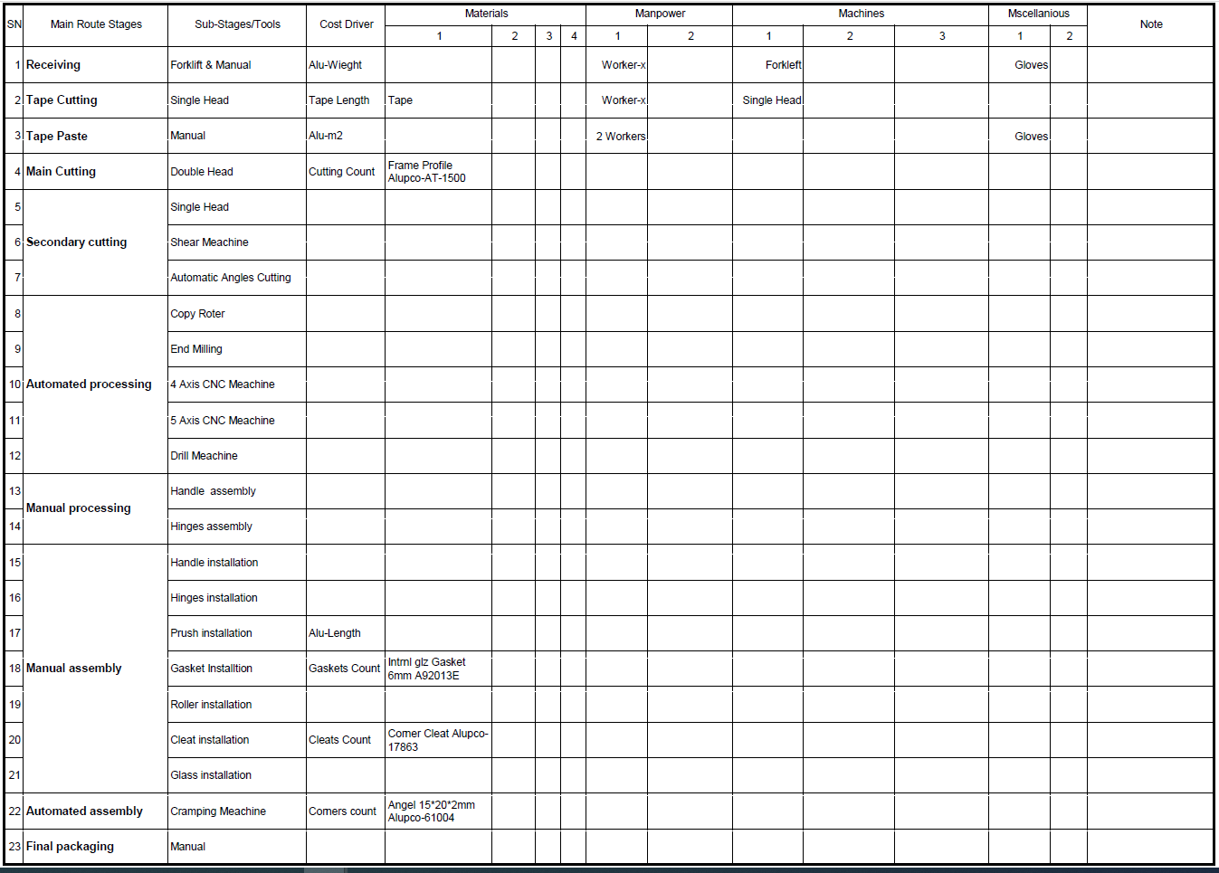
Planning - industrial Costs ABC Analyzing & Apply routes – Cost Driver

Slide 30
Planning - Product Cost Structure Standardization – Industrial management

Slide 31
Planning - Product Cost Structure Standardization – Industrial management

Slide 32
Planning - Product Cost Structure Standardization – Industrial management

Slide 33
Planning - Product Cost Structure Standardization – Industrial management

Slide 34
Planning - Product Cost Structure Standardization – Industrial management

Slide 35
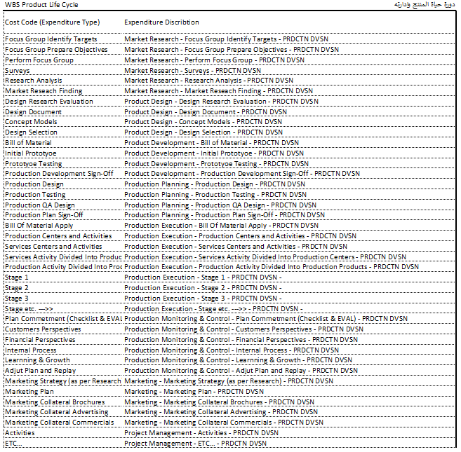
Planning - Industrial Cost Structure Standardization detailed – Production Management

Slide 36
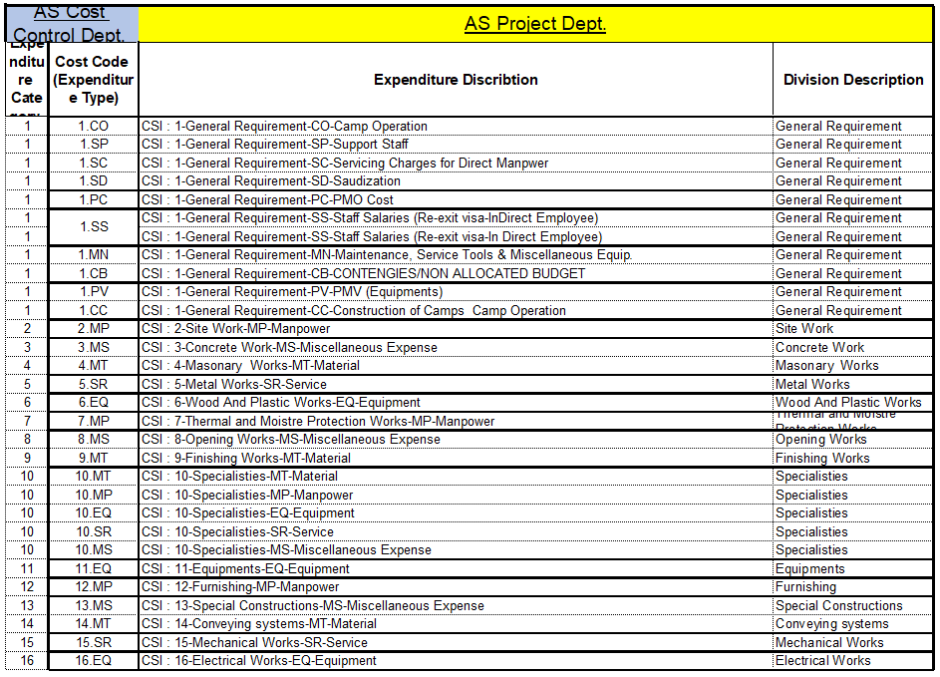
Planning - Project Cost Structure Standardization Detailed – Project management

Slide 37
Planning - Time Schedule (WBS - Red Sea) - Cost Structure Standardization
Activity ID | Activity Name | Original Duration | Start | Finish | Budgeted Total Cost
HC1 | Aluminum & Glazing-Alusystems-BL-R01 |  | 665 | 01-أكتوبر-23 | 26-يوليو-25 | 28,994,056.00
General |  | 665 | 01-أكتوبر-23 | 26-يوليو-25 | 434,910.84
HC1.C27.GEN.CO.0001 | Commencement Date | 0 | 45200 |  | 0
Section / Contract Milestones |  | 549 | 24-يناير-24 | 26-يوليو-25 | 0
Mochup / Benchmark |  | 0 | 24-يناير-24 | 24-يناير-24 | 0
HC1.C27.GEN.BM.0002 | 1.0.1 Completion and acceptance of First in Place Benchmark for Project | 0 |  | 24-Jan-24* | 0
The Mound |  | 238 | 23-مايو-24 | 16-يناير-25 | 0
HC1.C27.L02.MO.0007 | 1.0.7 Manufacture, Deliver and Install all Works - The Mound - Level 02 | 0 |  | 23-May-24* | 0
HC1.C27.L03.MO.0006 | 1.0.8 Manufacture, Deliver and Install all Works - The Mound - Level 03 | 0 |  | 14-Jul-24* | 0
HC1.C27.L04.MO.0005 | 1.0.9 Manufacture, Deliver and Install all Works - The Mound - Level 04 | 0 |  | 18-Jul-24* | 0
HC1.C27.L01.MO.0003 | 1.0.5 Manufacture, Deliver and Install all Works - The Mound - Level 01 | 0 |  | 02-Jan-25* | 0
HC1.C27.L05.MO.0004 | 1.0.10 Manufacture, Deliver and Install all Works - The Mound - Level 05 & 06 | 0 |  | 16-Jan-25* | 0
The Ring |  | 315 | 28-مايو-24 | 08-أبريل-25 | 0
HC1.C27.L00.RI.0011 | 1.0.2 Manufacture, Deliver and Install all Works - The Ring - Level 00 | 0 |  | 28-May-24* | 0
HC1.C27.L01.RI.0010 | 1.0.3 Manufacture, Deliver and Install all Works - The Ring - Level 01 | 0 |  | 13-Jun-24* | 0
HC1.C27.L00.RI.0009 | 1.0.11 Manufacture, Deliver and Install all Works - The Ring - Level 00 (Leave out Area) | 0 |  | 27-Feb-25* | 0
HC1.C27.L01.RI.0008 | 1.0.12 Manufacture, Deliver and Install all Works - The Ring - Level 01 (Leave out Area) | 0 |  | 08-Apr-25* | 0
The Beach |  | 0 | 19-أغسطس-24 | 19-أغسطس-24 | 0
HC1.C27.L00.BE.0012 | 1.0.4 Manufacture, Deliver and Install all Works - The Beach - Level 00 | 0 |  | 19-Aug-24* | 0
The Tail |  | 10 | 01-مايو-25 | 11-مايو-25 | 0
HC1.C27.L01.TA.0014 | 1.0.13 Manufacture, Deliver and Install all Works - The Tail - M03 Zone T1 - Level 01 | 0 |  | 01-May-25* | 0
HC1.C27.L02.TA.0013 | 1.0.14 Manufacture, Deliver and Install all Works - The Tail - M03 Zone T1 - Level 02 | 0 |  | 11-May-25* | 0
Time for Completion |  | 0 | 26-يوليو-25 | 26-يوليو-25 | 0
HC1.C27.GEN.CO.0015 | 1.0.15 Time for Completion for the Whole of the Works | 0 |  | 26-Jul-25* | 0
Key / Control Milestones |  | 473 | 24-يناير-24 | 11-مايو-25 | 0
Mochup / Benchmark |  | 0 | 24-يناير-24 | 24-يناير-24 | 0
HC1.C27.GEN.BM.2882 | 1.2.1 Completion and acceptance of First in Place Benchmark for Project | 0 |  | 24-يناير-24 | 0
The Mound |  | 282 | 09-أبريل-24 | 16-يناير-25 | 0
Level 01 |  | 0 | 02-يناير-25 | 02-يناير-25 | 0
HC1.C27.L01.MO.2883 | 1.2.5 The Mound - Level 01 - Zone M3 (Spa & Fitness) | 0 |  | 02-يناير-25 | 0
Level 02 |  | 44 | 09-أبريل-24 | 23-مايو-24 | 0
HC1.C27.L02.M1.2884 | 1.2.10 The Mound - Level 02 - Zone M1 | 0 |  | 09-أبريل-24 | 0
HC1.C27.L02.M3.2885 | 1.2.12 The Mound - Level 02 - Zone M3 | 0 |  | 24-أبريل-24 | 0

Slide 38
Planning - Product Cost Structure Standardization – Industrial management

Slide 39
Planning - Project Cost Structure Standardization – Project management
اسم المشروع
نلاحظ هنا ما يلي:
1- تم توزيع التكلفة على أنشطة الشركة من إدارة مشاريع وألمنيوم ودهان وحديد وزجاج وخشب
2- تم تصنيف تكاليف كل قطاع الى 5 تصنيفات 4M+S ليتناسب ذلك مع عدة استخدامات
أ. حسابات التكاليف: حيث يتم تصنيف التكلفة حسب التكاليف الصناعية وأحدث نظرياتها العلمية
ب. الحسابات العامة: حيث يتم الترحيل من كل قطاع الى الحسابات العامة لتعكس القوائم المالية لحظة بلحظة
ج. إدارة الجودة: يسهل التصنيف الموضح لإدارة الجودة استخراج البيانات المطلوبة واستخدامها في وضع نقاط تفتيش check-points
واستخدام أساليب الجودة وتحليلاتها المختلفة لتحديد أسباب المشكلات وكيفية حلها
د. المكتب الفني: حيث تم اعداد التصنيفات حسب أحدث المعايير CSI لتسهيل التخطيط والمتابعة
هـ. إدارة الإنتاج: يتم هيكلة التكاليف بما يتناسب وكل صناعة مع الأخذ في الحسبان أحدث أساليب تصنيف التكاليف ABC
و . مراقبة التكاليف: يسهل على إدارة التكاليف تتبع التكلفة ومقارنتها بالموازنات والخطط ودراسة مخاطر المشاريع وتكلفة الفرصة البديلة

Slide 40
Planning - Project Cost Structure Standardization – Project management

Slide 41
Planning - Project Cost Structure Standardization – Project management

Slide 42
Planning - Project Cost Structure Standardization – Project management

Slide 43
Planning - Project Cost Structure Standardization – Project management

Slide 44
Planning - Project Cost Structure Standardization – Project management

Slide 45
Planning - Project Cost Structure Standardization – Project management

Slide 46
Planning - Project Cost Structure Standardization – Project management

Slide 47
Planning - Project Cost Structure Standardization – Project management

Slide 48
Planning - Project Cost Structure Standardization – Project management

Slide 49
Project/Product Budgeting Based on WBS & ABC
Partial Project Budget | 10239 – Fakeeh hospital
Partial Product Budget 10239 – Fakeeh hospital
Activity ID | Activity Name | Original Duration | Start | Finish | Quantity | Budgeted Total Cost
FK1 | ALU-BL-R01 | HC1 | Aluminum & Glazing-Alusystems-BL-R01 | 665 | 01-أكتوبر-23 | 26-يوليو-25 |  | 4,514,682.48
General |  | 214 | 2023-03-10 | 2023-10-10 |  | 434,910.84
FK1.C11.GEN.CO.0001 | Commencement Date |  |  |  |  | -
Section / Contract Milestones |  |  |  |  |  | -
Mobilization |  |  |  |  |  | -
Design, Procurements, Materials Fabrication & Delivery to Site & Installation |  | 210 | 2023-03-10 | 2023-10-06 | 100% | 434,910.84
Materials Submission, .Shop Drawings, Mochup & Submital & Approval |  | 45 | 2023-03-10 | 2023-04-24 | 70% | 304,437.59
FK1.C11.GEN.CO.02 | Mochup & Submital & Approval | 14 | 2023-03-17 | 2023-03-31 | 20% | 86,982.17
FK1.C11.GEN.CO.03 | Procurement | 135 | 2023-04-25 | 2023-09-07 | 25% | 108,727.71
FK1.C11.GEN.CO.04 | Fabrication | 140 | 2023-05-09 | 2023-09-26 | 25% | 108,727.71
Installation |  | 140 | 2023-05-23 | 2023-10-10 | 30% | 130,473.25
المنتج | الكمية المنتجة بالوحدة | مواد مباشرة |  | أجور مباشرة |  | تكاليف تشغيل الآلات |  | تكاليف صناعية أخرى |  | التكلفة الصناعية للوحدة | م عمومية وإدارية |  | متوسط التكلفة للوحدة | اجمالي التكاليف
 |  | للوحدة | الإجمالي | للوحدة | الإجمالي | للوحدة | الإجمالي | للوحدة | الإجمالي |  | للوحدة | الإجمالي
ALUPCO 56 Hinged Widow | 205 | 187.11 | 38,357.98 | 18.47 | 3,785.53 | 45.17 | 9,259.57 | 13.77 | 2,823.50 | 264.52 | 18.52 | 3,795.86 | 283.04 | 58,022.44
 | - | - | - | - | - | - | - | - | - | - | - | - | - | -
 | - | - | - | - | - | - | - | - | - | - | - | - | - | -
 | - | - | - | - | - | - | - | - | - | - | - | - | - | -
Grand Total | 205 | 187.11 | 38,357.98 | 18.47 | 3,785.53 | 45.17 | 9,259.57 | 13.77 | 2,823.50 | 264.52 | 18.52 | 3,795.86 | 283.04 | 58,022.44
ملاحظات: |  | 66% |  | 7% |  | 16% |  | 5% |  | 93% | 7% |  | التكاليف:
 | 1- يوجد انخفاض في معدل المواد المباشرة نظراً لعدم دقة البيانات الواردة من المحطات خاصة |  |  |  |  |  |  |  |  | 179% | 13% |  | الهامش شامل القيمة المضافة:
 | 2- تم تحميل م إدارية وعمومية بنسبة 4% من اجمالي التكاليف يجب ألا تتعدى المصروفات الإدارية 10% من اجمالي التكاليف |  |  |  |  |  |  |  |  |  |  |  | الربح:
 | 3- تم حساب التكاليف للكميات المباعة فعلياً بغض النظر عن الكميات المنتجة لعدم وجود دقة في تقارير الإنتاج |  |  |  |  |  |  |  |  |  |  |  | الربح قيمة:
It Should be per Quantity Material, Manpower, Machines, MSc.

Slide 50
Planning - Cost Structure Standardization – Top management

Slide 51
Planning - Cost Structure Standardization – Top management

Slide 52
Planning - Cost Structure Standardization – Top management

Slide 53

Outsourcing (Alternatives) study
Which one return my money ASAP
Which One Achieves my Dream ROI

Slide 54
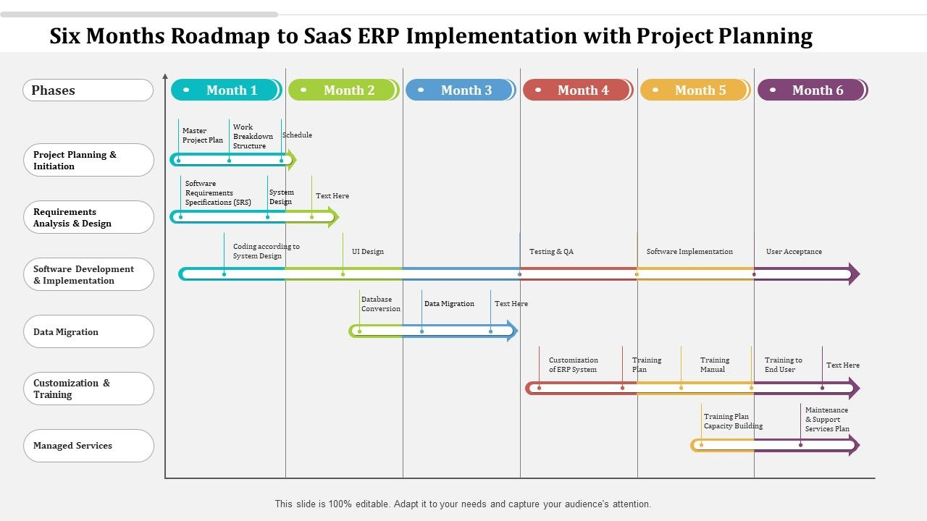
ERP System Implementation (Integration)

Slide 55
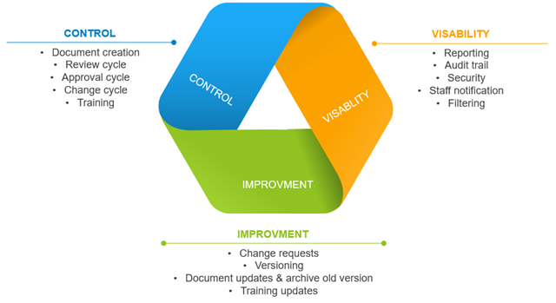
Documents lifecycle & Control (Integration)

Slide 56
The end thanks

